Slide 1

We deserve arrays • 10.11.2021 • Milestone 2

Slide 2
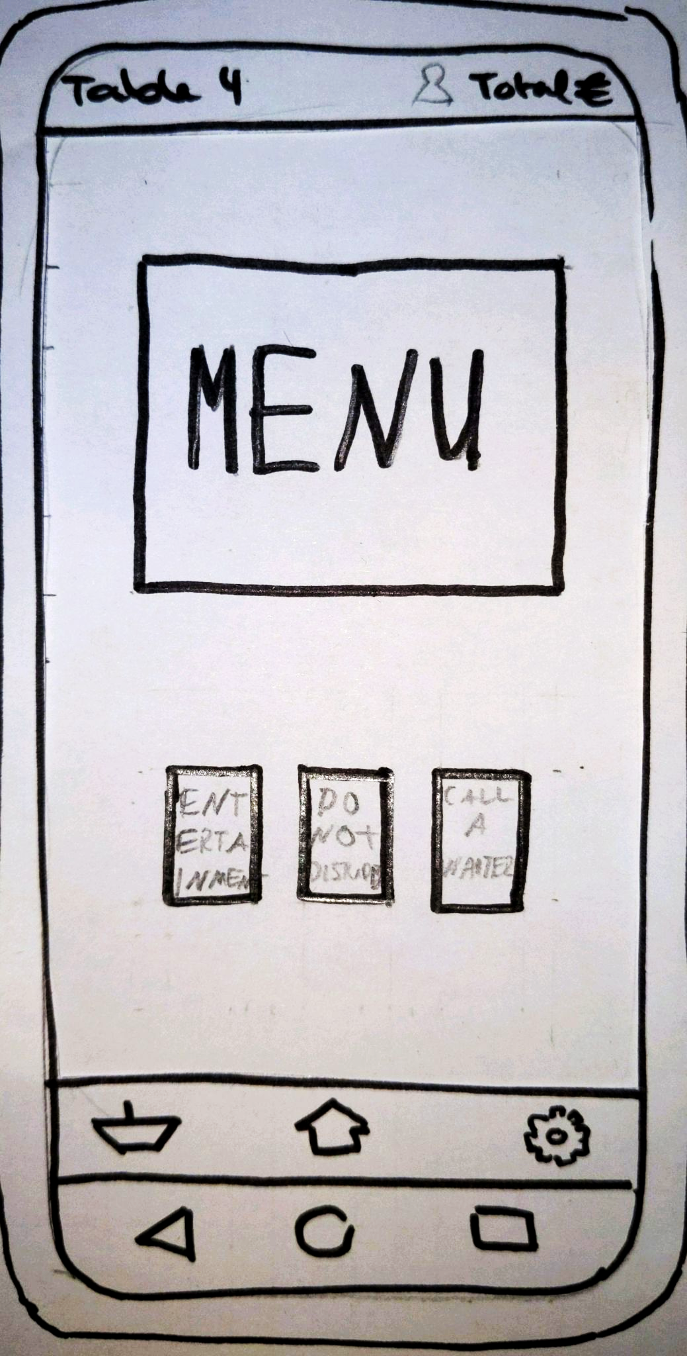
Requirements:
Main functions accessible with one click
Current status visible at all times
Design principles:
Aesthetic and minimalist design
User control and freedom
Consistency and standards
Heuristic evaluation:
Better “button” indication
Indication of order size
Text below icons
Notes:
Current status: Current bill, Table number, number of people
Design principles: -Aesthetic and minimalist design → No unnecessary clutter
-User control… → Every major function available from one screen; Nav bar of phone and of app -Consistency and standards → Always same bar at top and bottom
Heuristic eval: -Buttons need to look more like buttons
-Icon to show, how many items are in the cart right now
-Text below icons to increase recognizability

Slide 3
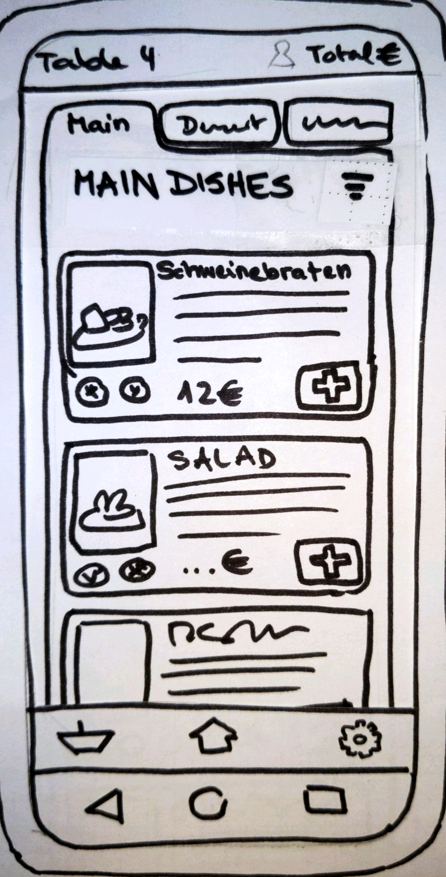
Requirements:
Check for dietary needs
User can order within 15 seconds
Design principles:
Flexibility and Efficiency of use
Visibility of system status
Heuristic evaluation:
Missing headline
How can hidden menus be displayed, when ordering for other people?
Notes:
Show all /FIlter button

Slide 4
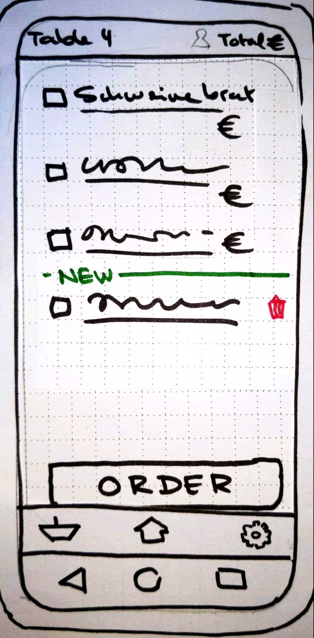
Requirements:
View total costs along with a list of ordered and not yet ordered items
Order food more than once in a single sitting
Design principles:
Visibility of system status
User control and freedom
Error prevention
Heuristic evaluation:
Confirmation and Success Pop-Up
Access dish detail view

Slide 5
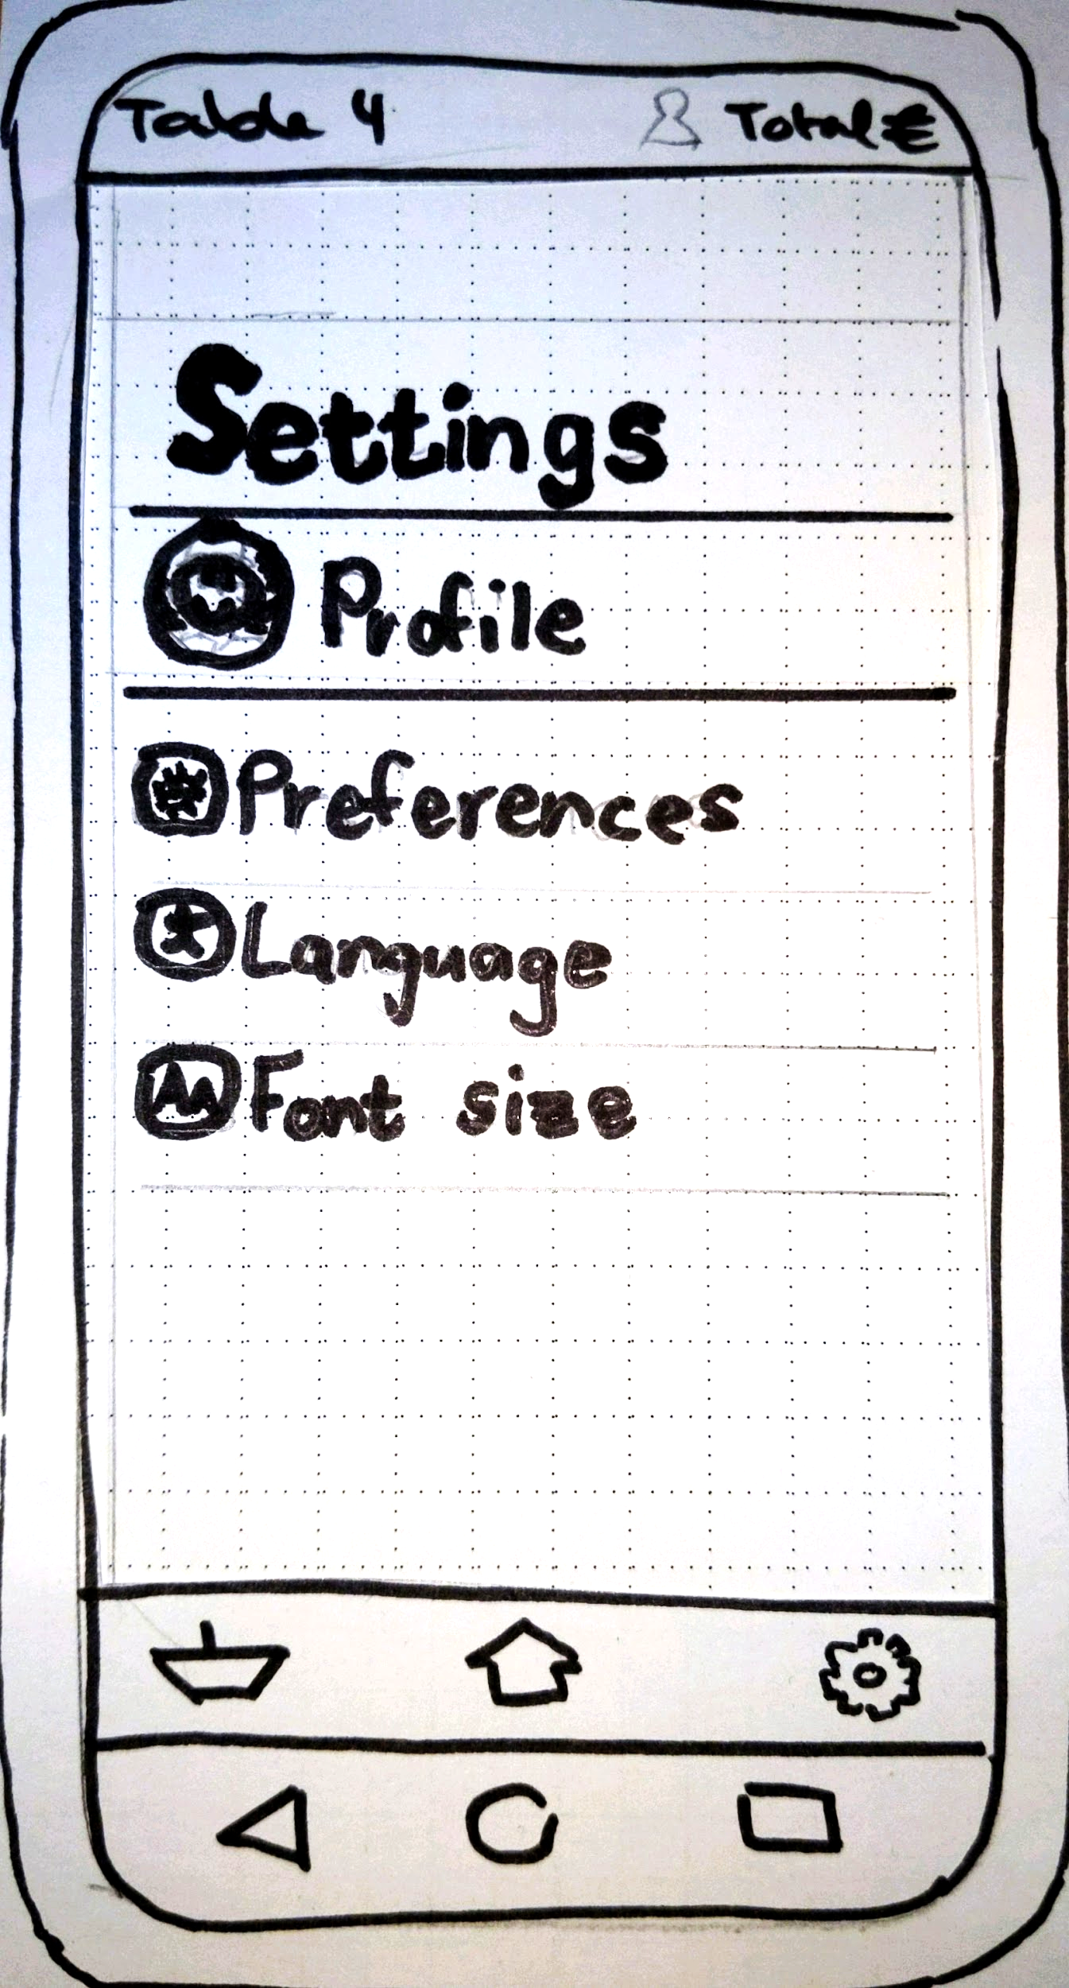
Requirements:
Access and change in-app preferences, languages, and font size
Accessible to and accommodate all types of users.
Design principles:
Aesthetic and Minimalist design
User control and freedom
Heuristic evaluation:
Remove the "Profile" customization from our app.
Icons used in the settings window are not necessary
Links to other pages like About us, Help or Tutorials might be of help for the user.

Slide 6
Discussion

